Slide 1



Exam AZ-700: Designing and Implementing Microsoft Azure Networking Solutions Training Course

Slide 2



Tim Warner
Based in Nashville, TN, US
Central time zone
Twitter: @TechTrainerTim
Web: TechTrainerTim.com

Slide 3
Day 1 of 2 Agenda
Introduction
Hybrid Networking
Core Networking Infrastructure
Routing, Start

Slide 4
Day 2 of 2 Agenda
Routing, Finish
Secure and Monitor Networks
Private Access to Networks

Slide 5
Course Materials
timw.info/az700

Slide 6
Tim’s “Frankenstein Project”
timw.info/frankenstein

Slide 7
A Different Kind of Training
This is an Associate (not Fundamentals) certification, so we will move quickly and assume intermediate-level Azure skills
CompTIA Network+ covers the fundamentals
2 hours / 15 minute break / 1 hour 45 min
Plan on reviewing the playback recording

Slide 8
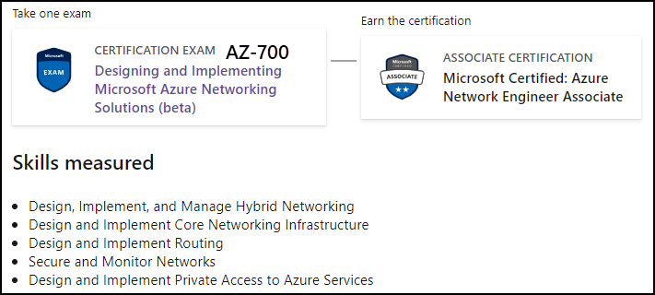
Azure Network Engineer Associate

Slide 9

Tim's Certification Study Model
Content knowledge
Test-taking skills
Practical application

Slide 10
Thank you!
Course materials: timw.info/az700
Twitter: @TechTrainerTim
Work: timw.info/ps
Web: TechTrainerTim.com

Slide 11


VM Networking

Slide 12

Site-to-Site VPN

Slide 13
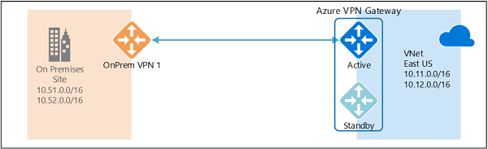
Active/Active VPN Topologies

Slide 14
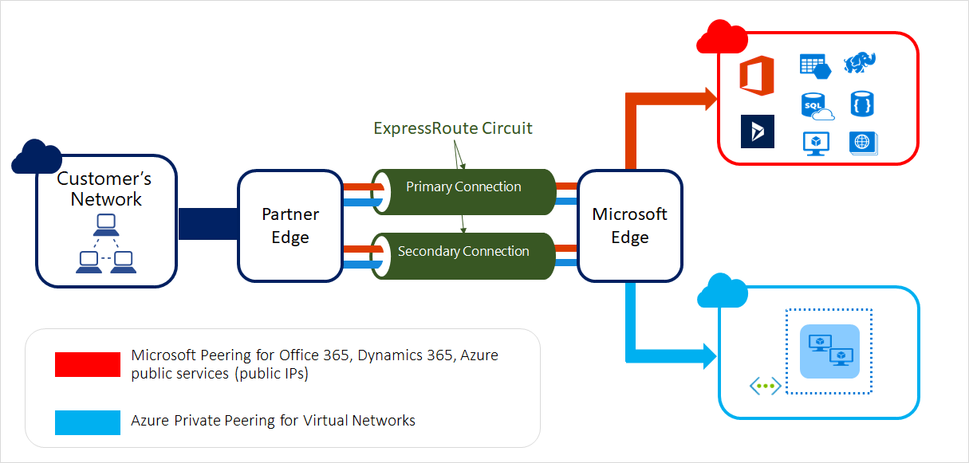
ExpressRoute Peering Types

Slide 15
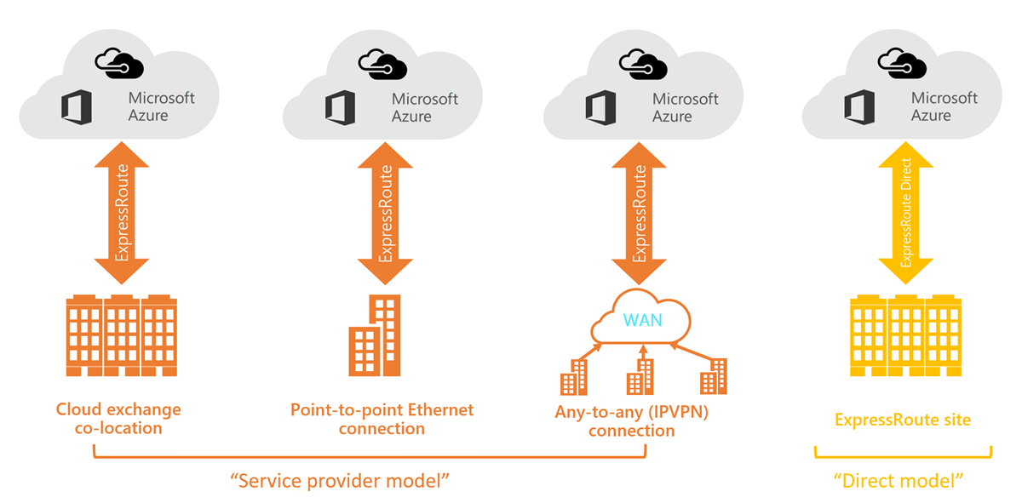
ExpressRoute Service Models

Slide 16
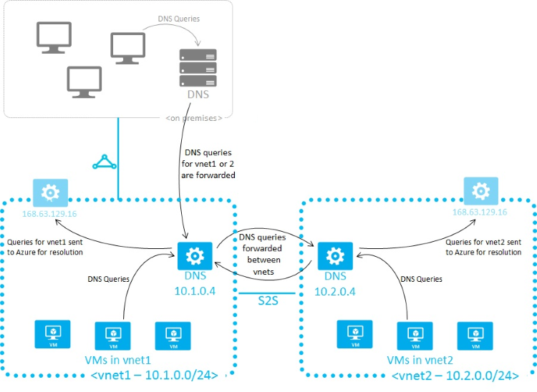
Azure Name Resolution

Slide 17
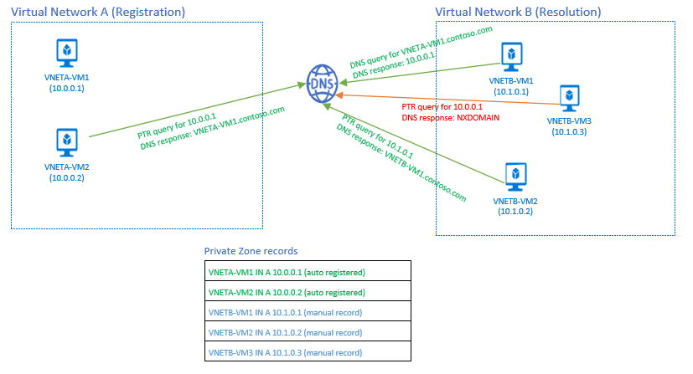
Azure DNS Private Zones

Slide 18
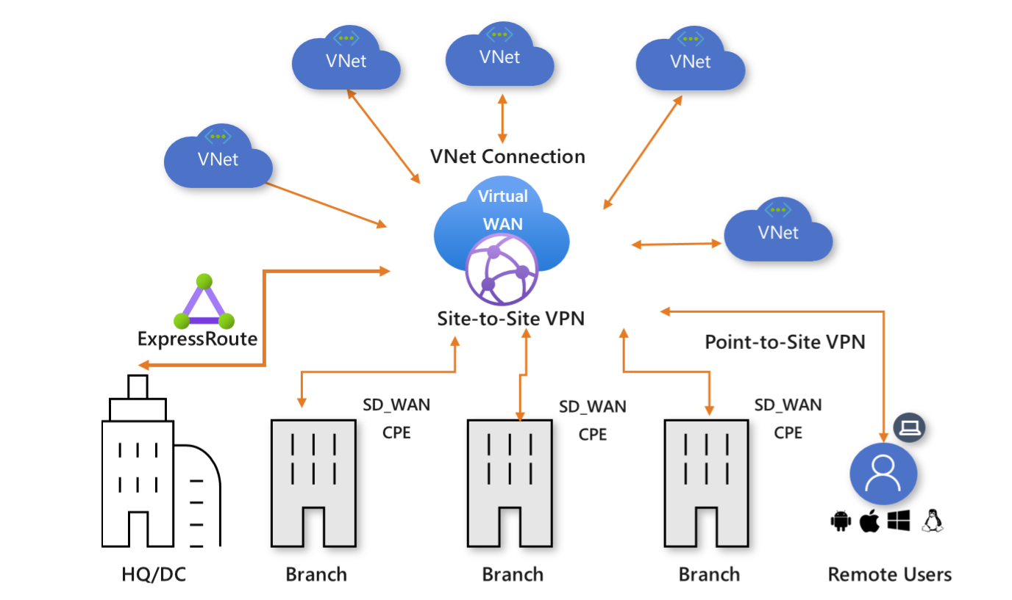
Virtual WAN

Slide 19
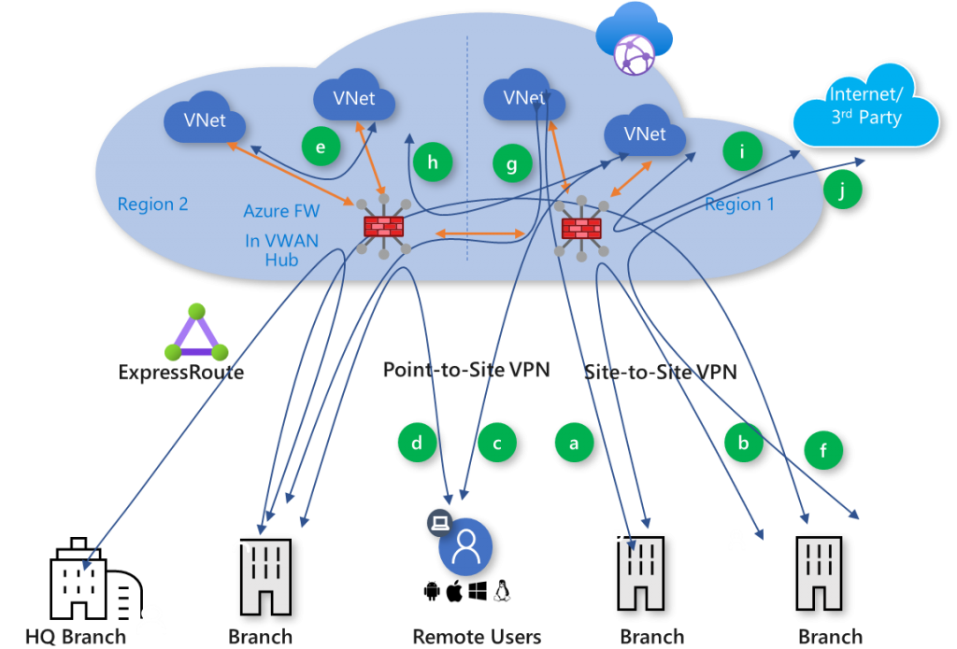
Secured Virtual Hub

Slide 20


Load Balancing

Slide 21

VNet Peering

Slide 22

Network Virtual Appliance

Slide 23

Azure Load Balancer

Slide 24

Application Gateway

Slide 25
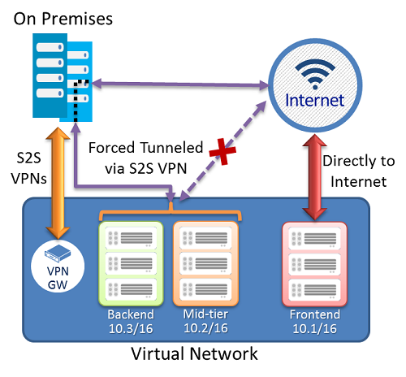
Forced Tunneling - S2S VPN

Slide 26
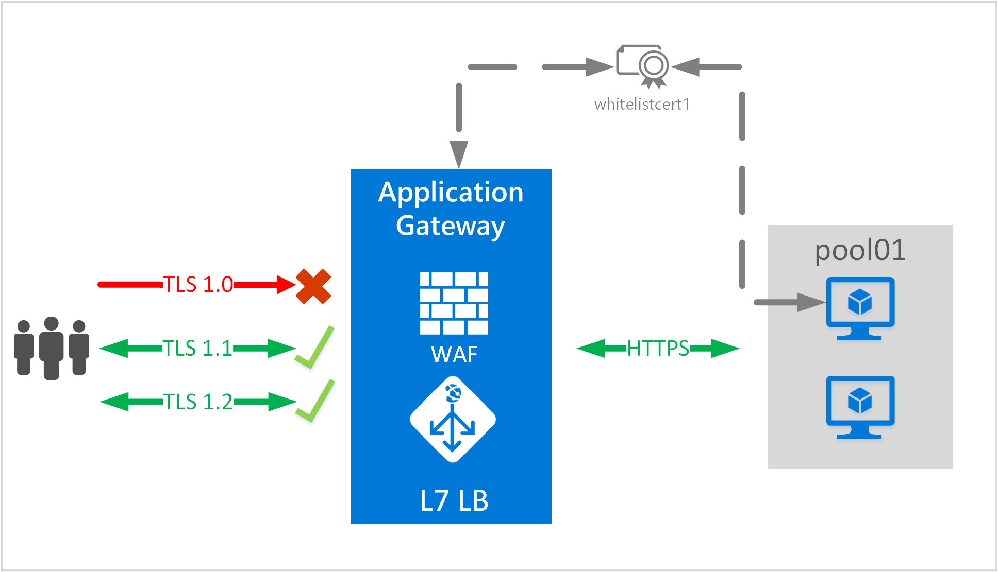
App Gateway E2E TLS

Slide 27
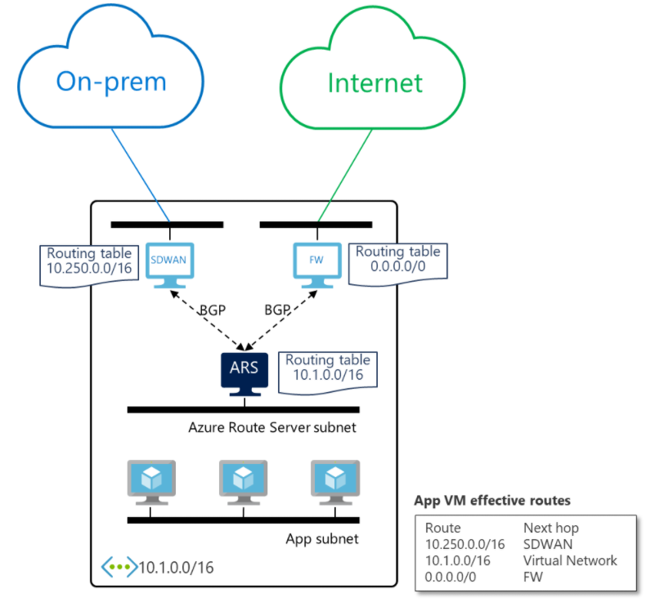
Azure Route Server

Slide 28
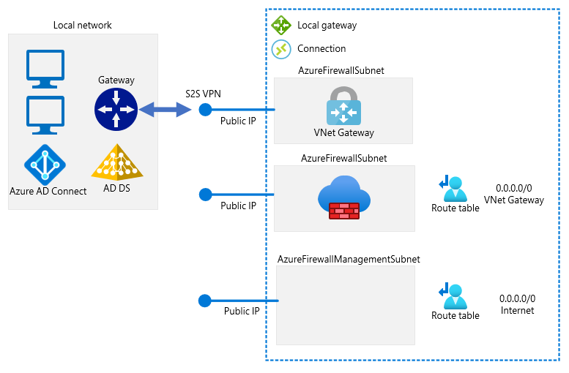
Forced Tunneling - Azure Firewall

Slide 29
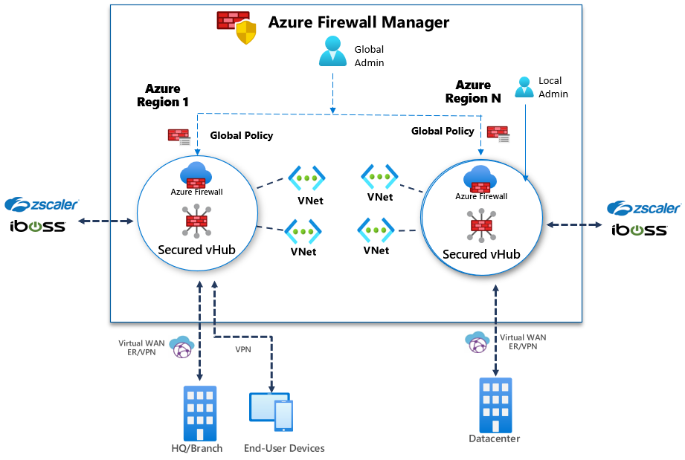
Azure Firewall Manager

Slide 30

Traffic Manager

Slide 31

Front Door Service

Slide 32
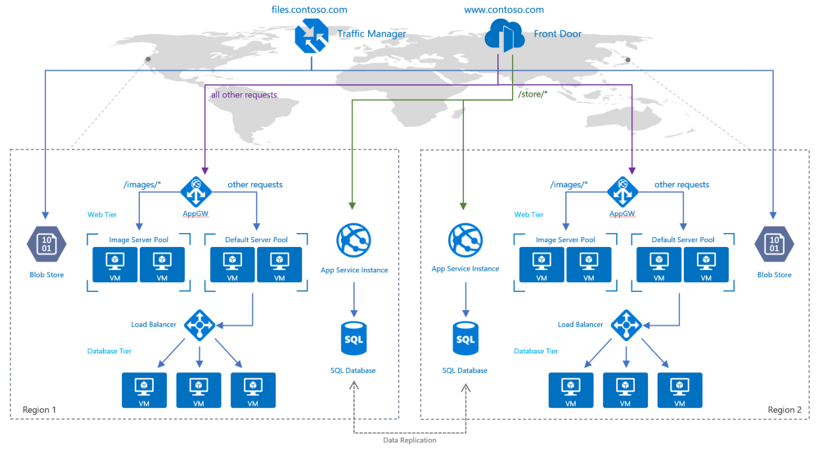
Traffic Manager vs Front Door

Slide 33
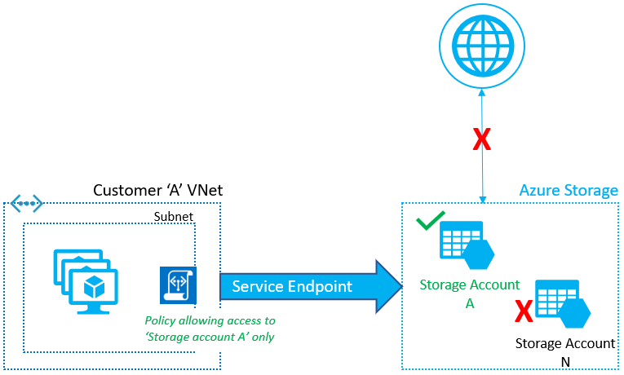
Service Endpoints

Slide 34
Private Endpoints

Slide 35
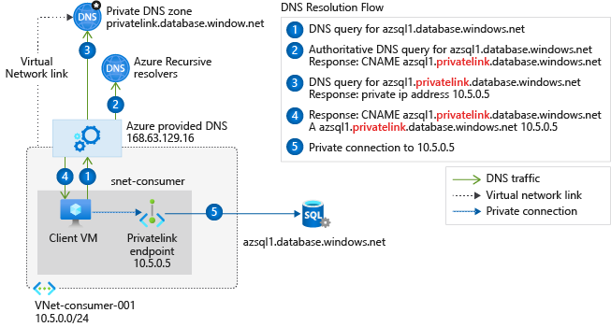
Private Endpoint DNS Config
Access from Azure

Slide 36
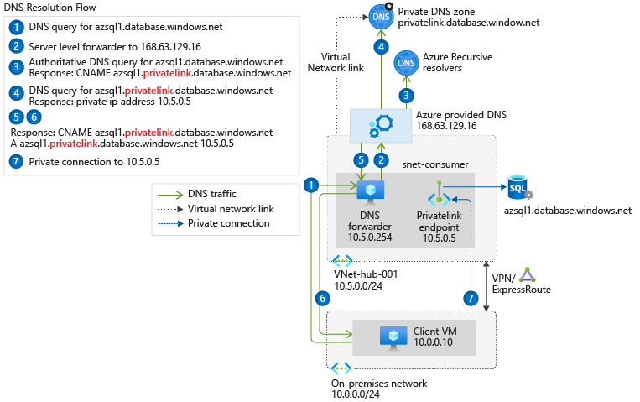
Private Endpoint DNS Config
Access from on-premises
Access from on-premises

Slide 37

Azure Monitor

Slide 38
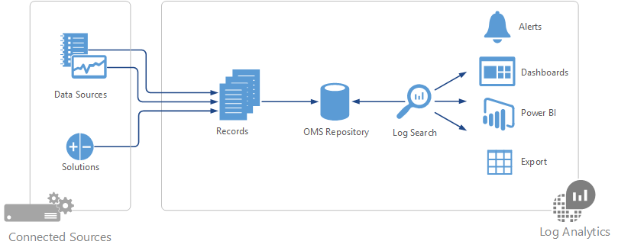

Log Analytics

Slide 39

Multiple Choice

Slide 40
Repeated Scenario
You need to move an Azure VM to another hardware host.
Solution: You redeploy the VM.
Does this solution meet the goal?
Yes
No

Slide 41

Select and Place

Slide 42

Build List and Reorder

Slide 43

Active Screen/Fill in the Blank

Slide 44

Case Study

Slide 45






Performance-Based Lab

Slide 46
Microsoft Online Testing Process
timw.info/online

Slide 47

Microsoft Online Testing Process

Slide 48

Microsoft Online Testing Process

Slide 49

Microsoft Online Testing Process

Slide 50

Microsoft Online Testing Process

Slide 51

Microsoft Online Testing Process

Slide 52

Microsoft Online Testing Process

Slide 53

Microsoft Online Testing Process

